Slide 1
The Woodstock Generation
Vietnam, Music, and Counter Culture in the 1960’s/70’s
Mr.Campbell

Slide 2
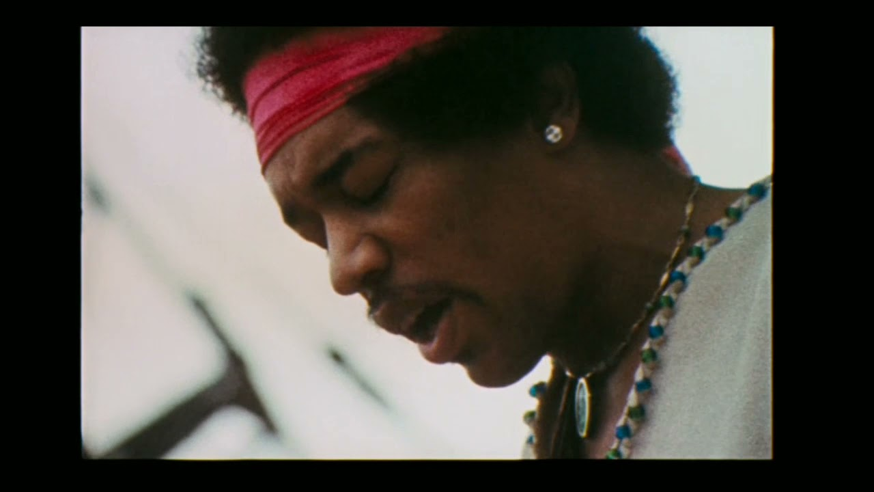
Jimi Hendrix Performs the National Anthem
August 18th, 1969

Slide 3
Some Questions
What was that all about?
What do you think about this unorthodox performance of the National Anthem?
What sounds was Hendrix making with his guitar and effects
Did they sound like anything?
Given what we know about the war thus far, why would this performance be significant for the American public?
What kind of message does it send to make noises reminiscent of bombs and planes during the Star Spangled Banner

Slide 4
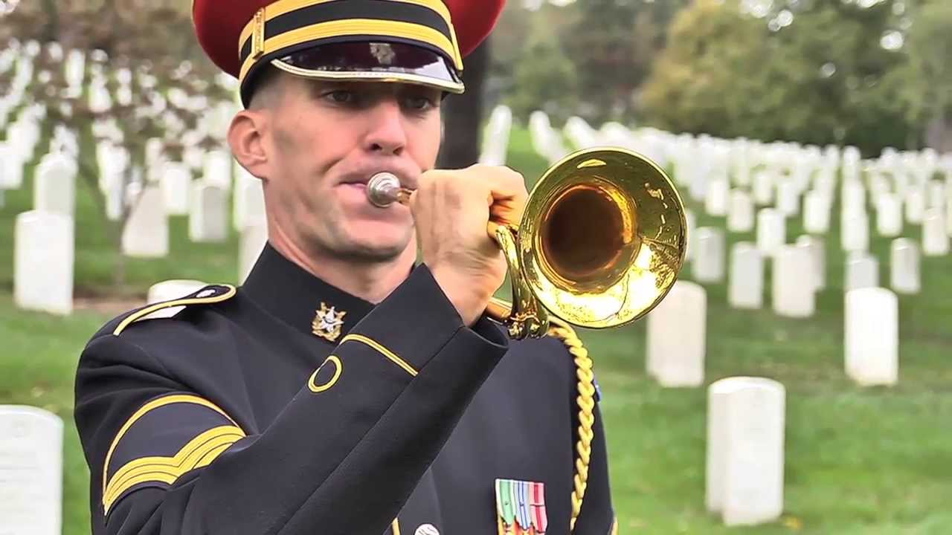
A Hidden Reference
TAPS
Jimi Hendrix also briefly makes an homage to Taps in his playing of The Star Spangled Banner
This song is used in ceremonies surrounding the death and remembrance of Soldiers
Does this add another layer to Hendrix’s message?

Slide 5
Music and Counter Culture
The Impact of music on the Woodstock Generation
The 1960’s were an integral time for massive significant shifts in American public life and culture
Music and in particular Rock music became the voice for a Generation as stars like The Beatles, Jimi Hendrix, Bob Dylan and many others were the voice of a time of experimentation
In particular music during this time became an integral part of activism with the Hippy movement
I’m sure you’ve heard of Hippies but who were they and what did they stand for? The 1960s were an integral time for massive American public life and culture shifts.
Music, and in particular Rock music, became the voice of a Generation as stars like The Beatles, Jimi Hendrix, Bob Dylan and many others were the voice of a time of experimentation.
Music, in particular, became integral to activism during this time, especially with the hippie movement.

Slide 6
The Hippies
The Hippie movement was a youth movement that advocated Non-violence Peace and Free love
The movement was one of the biggest conduits for resistance to the Vietnam war as they advocated for a lifestyle which rejected traditional American ideals such as religion, monogamy, gender norms, and adherence to traditional lifestyles in general
The Hippie movement is also known for its psychedelic colours, recreational use drugs, and most importantly their love of music as a way of life and liberating themselves from the oppressive shackles of the American way.
During this time the American teenager became a key political force and music and Counter Culture were a key part of their politicization and broader mobilization against the war effort in Vietnam

Slide 7
The Woodstock Music and Arts Fair
August 15th-1969
Woodstock has become synonymous with the Hippie movement and 1960’s-70’s counterculture
The festival hosted the days biggest acts and was meant to show that another way of life was possible
Woodstock has become a cultural object and a very important part of how resistance to the war is remembered through the embrace of non violent free living.
The event was actually a disaster as millions of people were in attendance and mudslides supply shortages and excessive drug used were abound throughout the three days causing major issues

Slide 8
The Impact of Music on Public Perception of the War
What is most important to understand is that music during the 1960’s and 70’s played a key role in shaping how the American Public perceived the war
Rock and Roll and folk music became some of the most impactful ways to protest around events of the war by bringing them to the forefront of public attention and critiquing the war through artistry
This will be our focus today to see how young folks during the 60’s and 70’s would have processed political events to a soundtrack which helped to contextualize and critique injustices during these times
Now for our activity

