Slide 1
Body Politics:
The History of Policing Queer Peoples in Canada
Justin Campbell

Slide 2
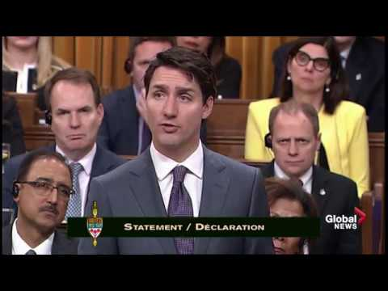
The “Gay” Apology
November 28th 2017
On the 28th of November 2017, Prime Minister Justin Trudeau issued an apology on behalf of the Canadian government to 2SLGBTQ+ people.
This has been referred to as the “Gay” apology in discourse around the topic
listen to the clip or read the longer statement on Minds online!

Slide 3
Recapping some background
What we know about 2SLGBTQ+ rights in Canada
As we know, In June 1969, the Canadian Government passed a bill (The Criminal Law Amendment Act) allowing men over the age of 21 to consent to homosexual activities and sex acts legally.
Full decriminalization down to the age of 14, which is the law for heterosexual relations, would not arrive until 1987 after years of protests.
A quick question: Why do you think the consent age for one group would remain lower than another? Why would this be significant, especially for young queer people in Canada?

Slide 4
A History of Policing in Canada
Before and After 1969
What is important however, is that before and after 1969 the 2SLGBTQ+ community was routinely attacked by police through various means for their identity
This is important as we must understand that discrimination was carried out by the Canadian state and specifically Police for decades
We will hear some testimony of some legendary Queer peoples in the documentary The Fruit Machine (2017) to show us what this discrimination looked like

Slide 5
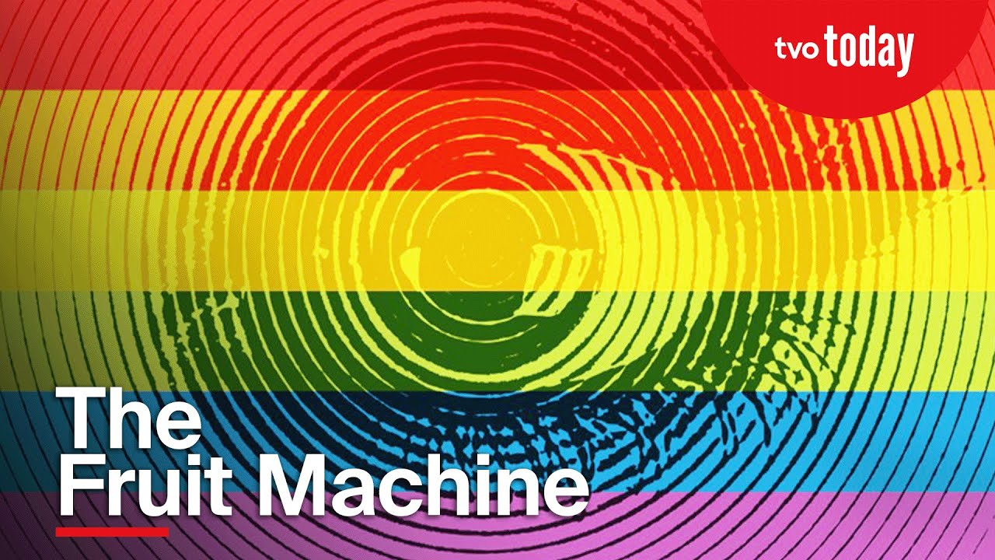
Testimony of Queer Peoples and their experiences with Police:
The Fruit Machine (2017)

Slide 6
Question 1: Did the testimony in the video surprise you? Why?
Question 2: Why might this be significant to understanding Trudeau’s apology??

Slide 7
The Toronto Bathhouse Raids
February 5th 1981
On the Night of February 5th, 1981, four bathhouses, also known as Bawdy Houses as Toronto Police raided major establishments frequented by homosexual men across the GTA
Bathhouses were common meeting grounds for homosexual men where they could relax and be part of a community. These places also provided private spaces for sexual intimacy in a “safe” environment.
Operation Soap constituted months of police work as the Barracks, The Club, Richmond Street Health Emporium, and Roman II Health and Recreation Spa were all raided simultaneously.
Members of Toronto’s Police brutalized and attacked many attendees and arrested 200 people within one night.

Slide 8
Our Task Today
What will the rest of class look like
Now that we understand the fraught nature of Queer people's relationship with the police in Canada, it is now our term as historians to make sense of Trudeau's apology and the history of policing 2SLGBTQ+ peoples in Canada.
I will be providing you with a copy of some articles from Body Politic. This legendary Canadian gay magazine was a voice for queer people at the time to voice their opinion.
You will read the selections of Body Politic (a magazine on LGBQT+ Issues in the 80’s) and use them to contextualize the apology and try to reconcile how the history of policing in Canada has impacted Queer communities throughout Canada’s history.

